Slide 1
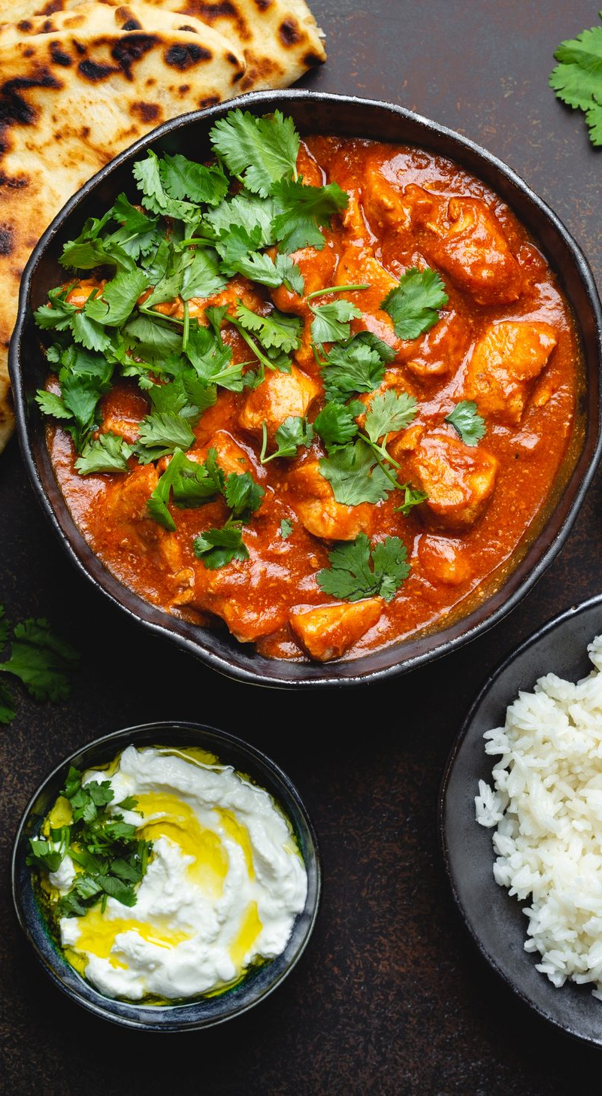
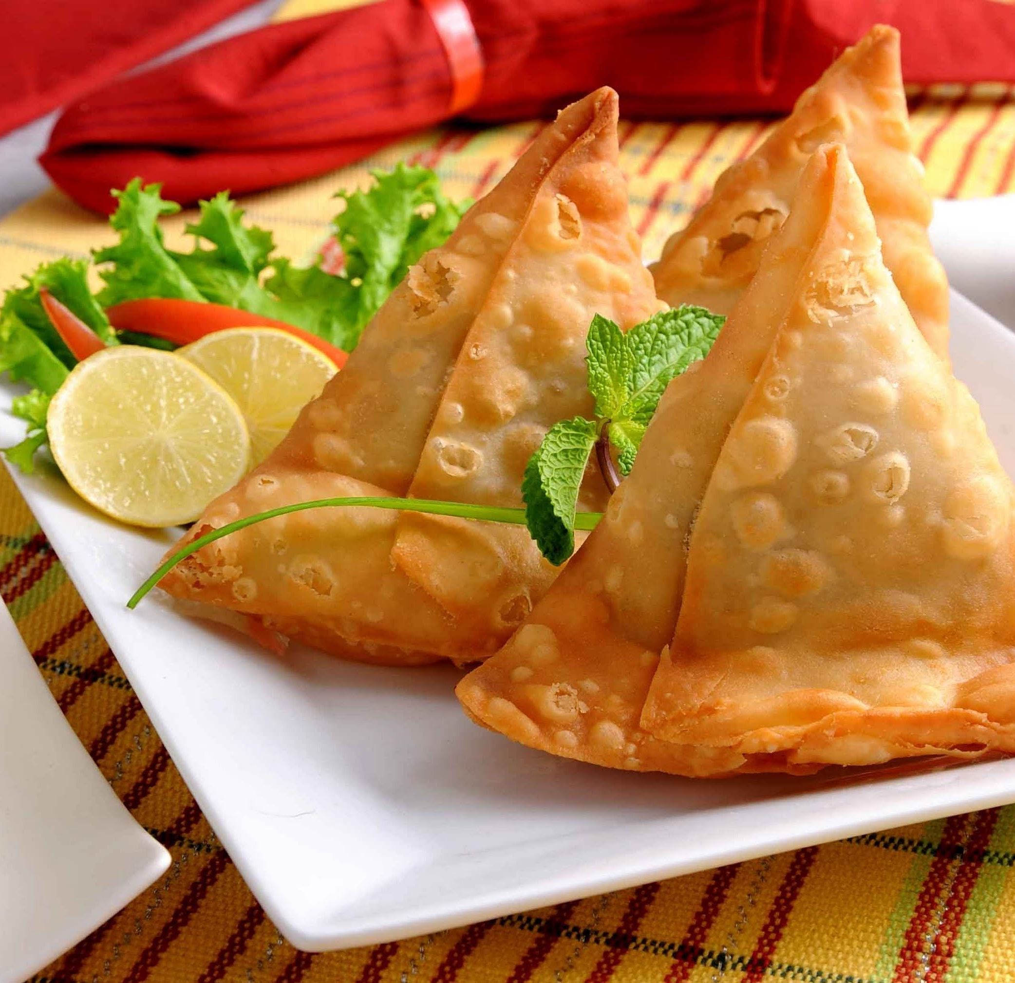
CELEBRATING Eid
WE ARE CELEBRATING Eid THIS MONTH THROUGH FOOD,
SHOWCASING THE DIVERSE CULTURES WITHIN FREMAN.
MAIN MEAL OPTIONS AVAILABLE ON FRIDAY 20th MARCH 2026
KEEMA CURRY
SERVED WITH BASMATI RICE,NAAN BREAD
AND SAMOSA
All other food options will also be available
e.g. Jacket Potatoes, Pasta Option and Salad Bar.

